Slide 1

Si Nonna’s FC Road Visitor Insights & Generator Analysis
Understanding our guest and finding the next big location
By Aradhana Bopche

Slide 2
Data Analysis
Time & Visit Patterns:- 54% visit on weekdays,46% on weekends. This shows that weekday traffic is slightly higher, likely due to regular diners, professionals, and students. Most visits happen at night, followed by afternoon and evening. Among weekdays, Friday has the highest footfall, followed by Thursday and Wednesday. On weekends, Saturday sees the highest visits, followed by Sunday.
Generators:-
Survey considered on 516 Customers
Home (43%) is the top reason people are at a location- most stay at home.
Shopping (23%) is the second most common purpose.
Work/Office (13%) and movies (11%) follow.
Visiting friends/relatives (6%) and college (4%) are less frequent reasons.

Slide 3
Home Generator Areas based on 222 customers
 | Location | Count | Percentage
1 | Shivajinagar, Pune | 23 | 10.36%
2 | Deccan, Pune | 21 | 9.46%
3 | MIT College / Anand Nagar, Pune | 20 | 9.01%
4 | Mayur Colony / Ideal Colony, Pune | 13 | 5.86%
5 | Model Colony, Pune | 12 | 5.41%
6 | Prabhat Road/Bhandarkar Road, Pune | 11 | 4.95%
7 | Dahanukar Colony / Kothrud Bus Stand, Pune | 10 | 4.50%
8 | Deenanath Mangeshkar Hospital / Patwardhan Bag,Pune | 7 | 3.15%
9 | ICC/ Senapati Bapat Road, Pune | 7 | 3.15%
10 | Apte Road / JM Road,Pune | 6 | 2.70%

Slide 4
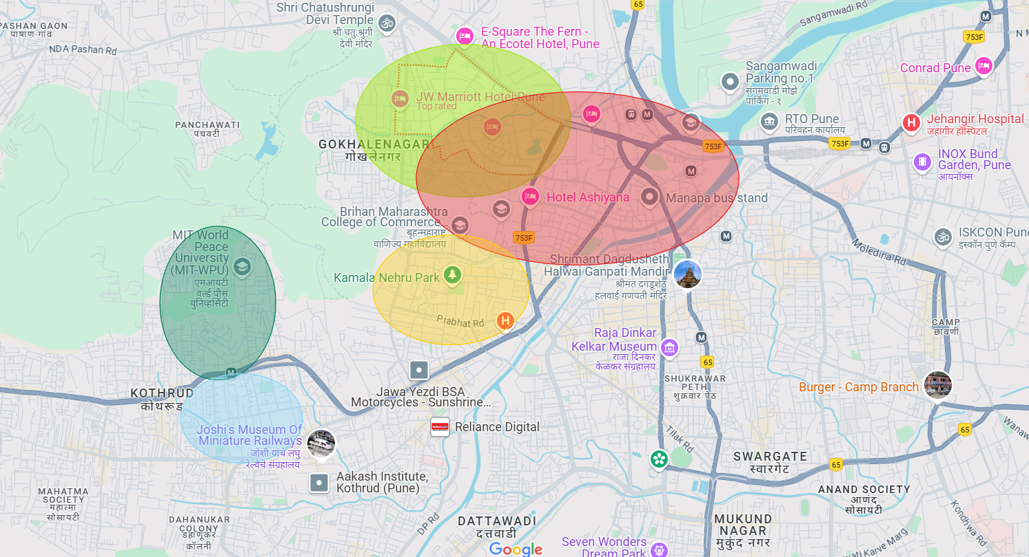
Model Colony
5.41%
Shivajinagar
10.36%
MIT College/Anand Nagar
9.01%
Deccan
9.46%
Mayur Colony/Ideal Colony
5.86%

Slide 5
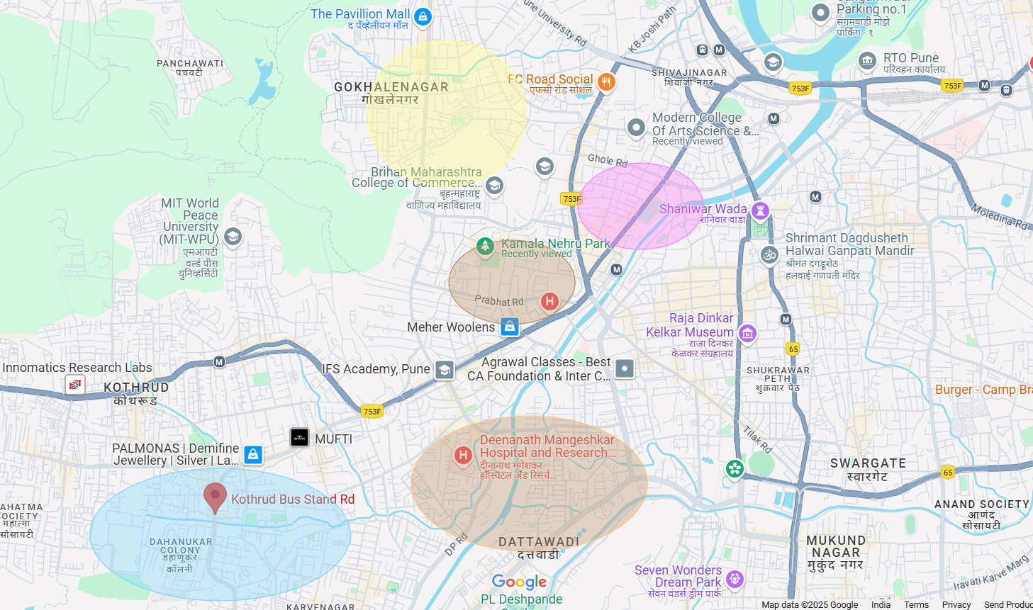
ICC/ Senapati Bapat Road
3.15%
Apte Road / JM Road 2.70%
Prabhat Road/Bhandarkar Road 4.95%
Deenanath Mangeshkar Hospital / Patwardhan Bag
3.15%
Dahanukar Colony / Kothrud Bus Stand
4.50%

Slide 6
Shopping Generator Areas based on 118 customers
 | Location | Count | Percentage
1 | FC Road, Pune | 82 | 69.49%
2 | Pavillion Mall, Pune | 12 | 10.17%
3 | JM Road, Pune | 10 | 8.47%
4 | Deccan, Pune | 4 | 3.39%
5 | Shivajinagar, Pune | 3 | 2.54%
6 | Kothrud, Pune | 2 | 1.69%
7 | Prabhat Road, Pune | 1 | 0.85%
8 | Lakshmi road, Pune | 1 | 0.85%
9 | Karve Road, Pune | 1 | 0.85%
10 | Peth, Pune | 1 | 0.85%

Slide 7
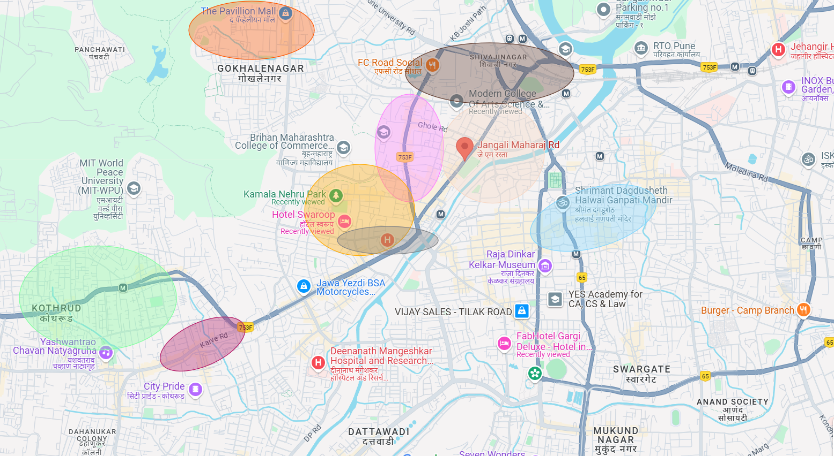
Shopping Generator
Pavillion Mall
10.17%
Shivajinagar 2.54%
FC Road 69.49%
JM Road 8.47%
Deccan 3.39%
Lakshmi Road 0.85%
Prabhat Road 0.85%
Kothrud 1.69%
Karve Road 0.85%

Slide 8
Work/Office Generator Areas based on 69 customers
 | Location | Count | Percentage
1 | Shivajinagar, Pune | 20 | 28.99%
2 | Deccan, Pune | 16 | 23.19%
3 | ICC/ Senapati Bapat Road, Pune | 15 | 21.74%
4 | Model Colony, Pune | 8 | 11.59%
5 | FC Road, Pune | 1 | 1.45%
6 | Sadashiv Peth, Pune | 1 | 1.45%
7 | Swargate, Pune | 1 | 1.45%
8 | Pune Railway Station, Pune | 1 | 1.45%
9 | Kothrud, Pune | 1 | 1.45%
10 | Yerwada, Pune | 1 | 1.45%

Slide 9
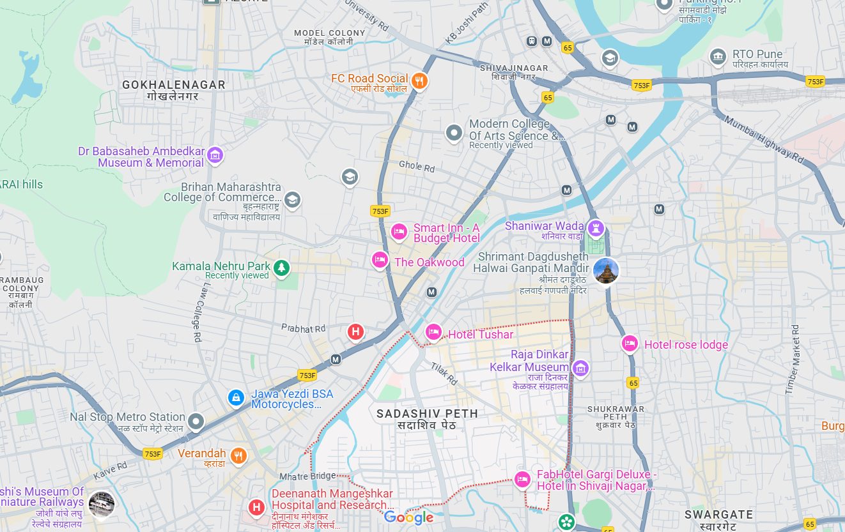
Model Colony 11.59%
ICC/ Senapati Bapat Road
21.74%
Shivajinagar 28.99%
FC Road
1.45%
Deccan 23.19%
Sadashiv Peth 1.45%

Slide 10
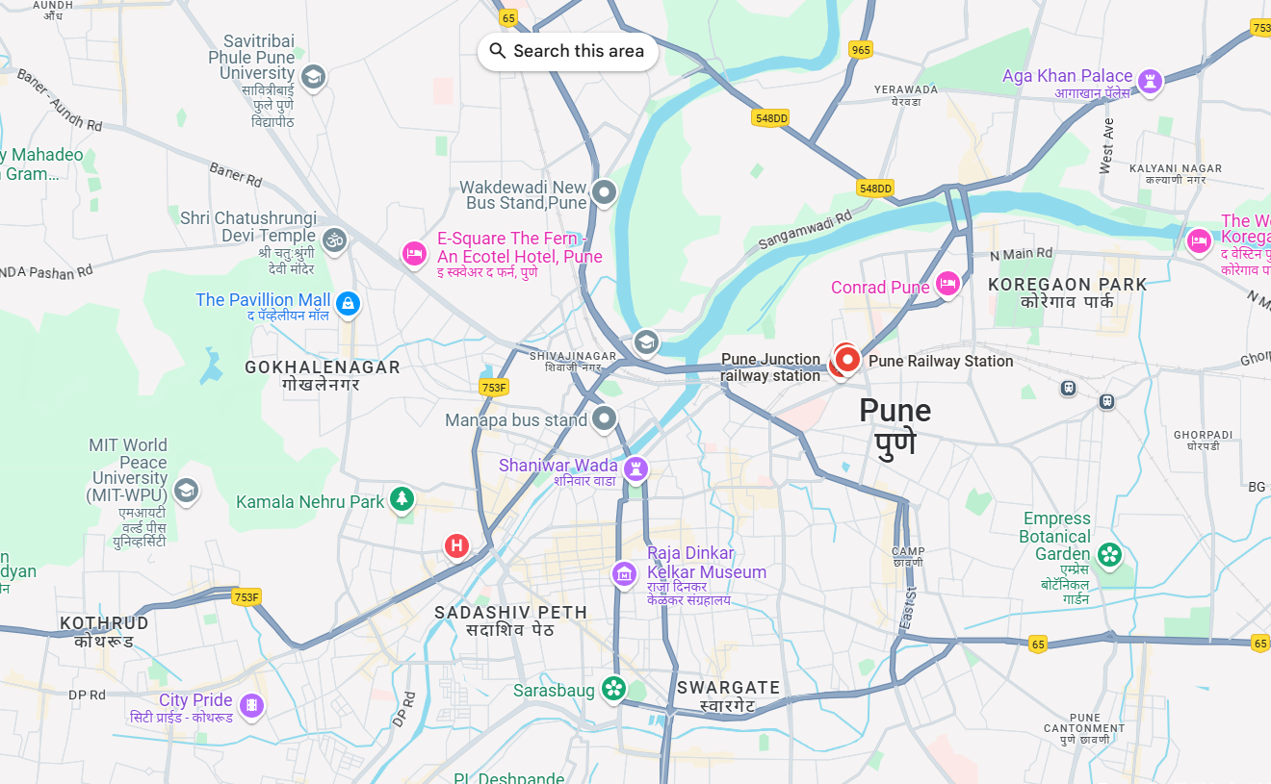
Work/Office Generator
Yerwada 1.45%
Pune Railway Station 1.45%
Kothrud 1.45%
Swargate 1.45%

Slide 11
Movie/Out for fun Generator Areas based on 56 customers
 | Location | Count | Percentage
1 | Pavillion Mall, Pune | 34 | 60.71%
2 | R Deccan, Pune | 9 | 16.07%
3 | E square, Pune | 3 | 5.36%
4 | Kothrud, Pune | 2 | 3.57%
5 | Sambhaji Park, Pune | 2 | 3.57%
6 | FC Road, Pune | 2 | 3.57%
7 | JM Road, Pune | 1 | 1.79%
8 | The mills, Pune | 1 | 1.79%
9 | Viman Nagar, Pune | 1 | 1.79%
10 | Law College Road, Pune | 1 | 1.79%

Slide 12
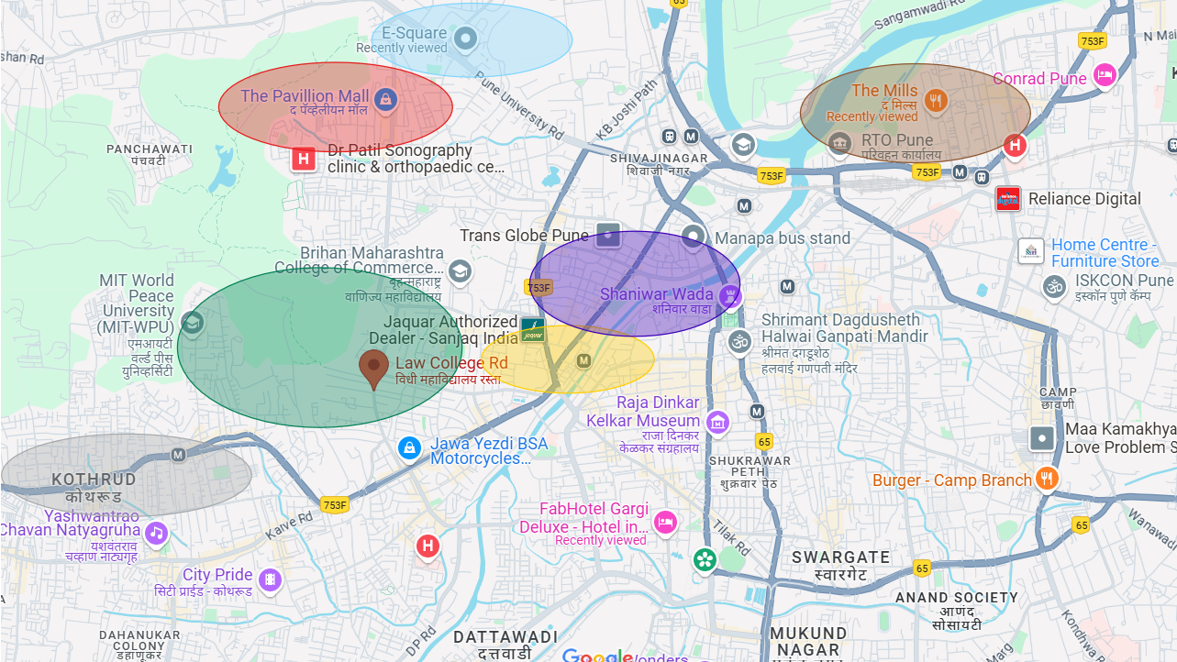
E Square 5.36%
Pavillion Mall
60.71%
The Mills 1.79%
Sambhaji Park 3.57%
Law College Road 1.79%
R Deccan 16.07%
Kothrud 3.57%

Slide 13
Demography and Consumer Behaviour
Demography
Gender: males (54.07%) followed closely by females (43.83%).
Profession: salaried professionals (48.26%), with students (29.26%) and entrepreneurs (16.28%).
Age: Young and career-driven 24–34 years (49.22%), followed by 18–24 years (35.08%).
Lifestyle: Upper-middle-class, living in 2BHK or 3BHK homes
High mobility-most own a car and two-wheeler (38%) or at least a car (25%)
Additionally, over 60% are unmarried, making them more likely to engage in spontaneous dining, entertainment, and shopping experiences.
Consumer Behaviour
Most people visit in groups of 3 (42.83%), followed by 2 (27.91%) and 4 (16.09%). Most people decide quickly — 52.33% within 30 minutes and 24.03% within 1–3 hours.
Visit Purpose: Casual meal (50.39%), followed by hanging out with friends (18.99%), family outings (11.63%), and dates (10.27%).
Discovery: Found mainly via friends and walk-ins, then social media. Around 68.22% come specifically to try sourdough, while 13.37% come for pizza with drinks and tiramisu.
Regulars come quarterly (17.64%), followed by monthly (16.86%). While 34.50% have never ordered food online. 30% eat out weekly, 27% dine 2–3 times a month. 29% visit fine-dine restaurants either once or 2–3 times a month.

Slide 14
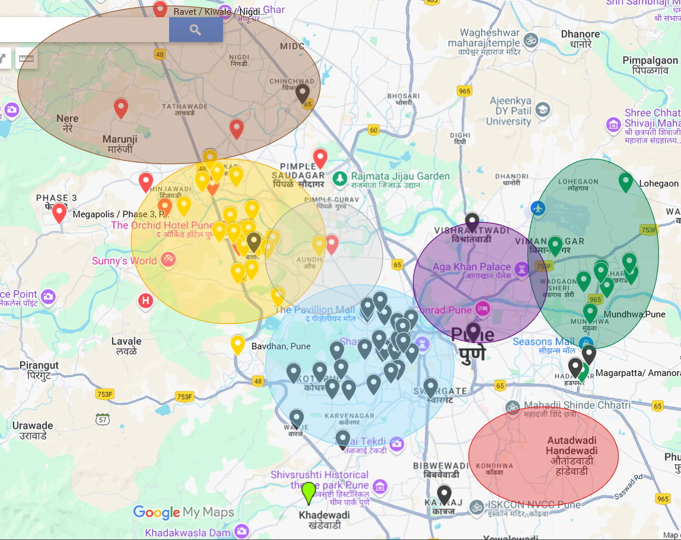
Suggestions on where to open a new store
Nanded City, Pune
Location-Western Pune, located off Sinhagad Road Near Dhayari, Vadgaon Budruk, Dhule Patil Nagar.
Infrastructure & Features
Schools: Pawar Public School
Retail Hub: Destination Center
Hospital: Nanded Multispeciality Hospital
IT Hub: Symphony IT Park
Clubhouse & Gym: Kridangan sports complex
Resident Profile:-Mostly upper-middle-class and affluent salaried professionals. Families with kids, working in IT, healthcare, manufacturing, education. Most residents own cars and 2-wheelers, dine out weekly, and shop online.
Premium Societies: Asawari, Rhythm Villas, Madhuvanti, Kalashree, Sarang
Opportunity: Low competition, strong spending capacity, community dining habits
Area: 700 acres, self-sustained township off Sinhagad Road
Covered Areas
Wakad
Balewadi
Kharadi
Aundh
Kalyani Nagar
FC Road
NIBM

Slide 15
THANK YOU!

